Slide 1
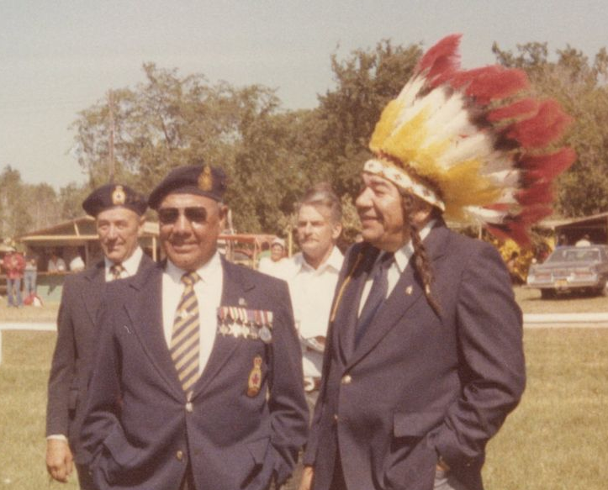
Peguis Community Garden 2011 - 2022
By Carl McCorrister

Slide 2
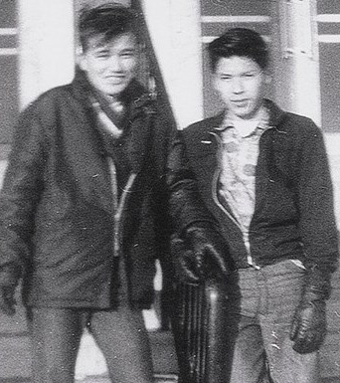
Introduction
Retired teacher (25 years)
Residential School Survivor
Have 4 children, 7 grandchildren
Served on Peguis Council from 1975-1979 (local control)
Returned to university
Community Garden Project – 12 years.

Slide 3
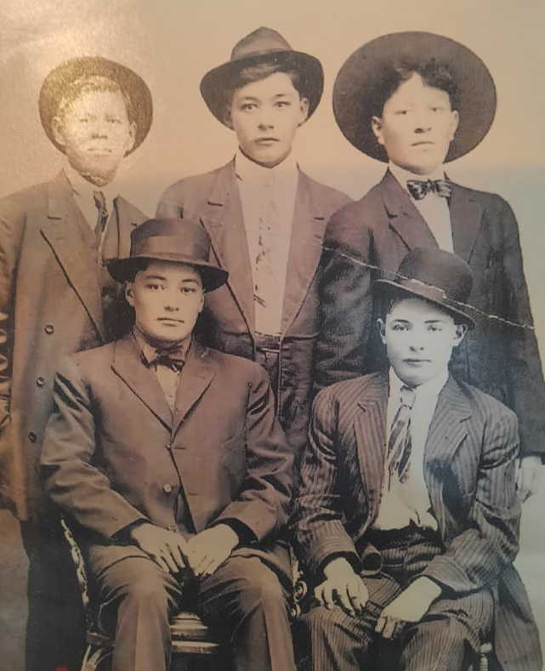
History of Peguis - Agriculture
Why is important to know our history

Slide 4
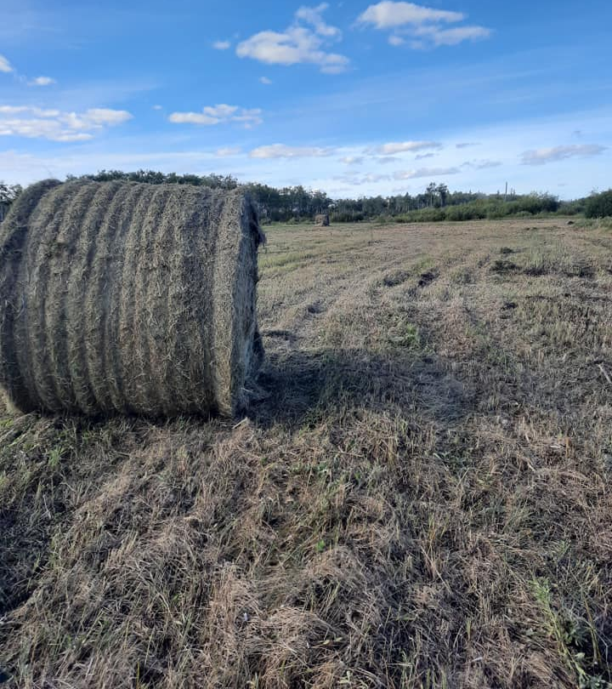
St. Peter’s Reserve – 1770’s to 1907.
A flourishing Community – Farming – Land use.
Retain
The Surrender of St. Peter’s Reserve 1907
The Move to Peguis, Agriculture would continue..
“We cannot preserve our nations unless we take action to restore Pride in our Traditions, achieve economic Self Sufficiency, develop independence of mind, and display courage in defence of our lands and Rights”….

Slide 5
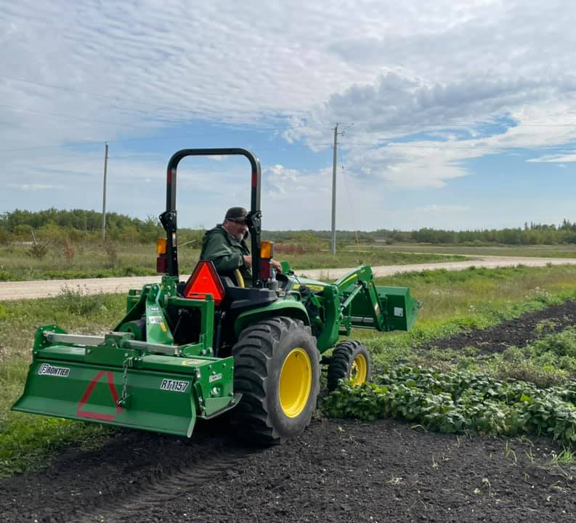
vision – To Regain our Heritage & Culture of Food Security…
In 2011, we started a 3 acre garden on Band Land, No funding, just a vision to return to the land.
Along with 4 others, we broke the land and started our community Garden..
Our Outcomes: To promote land use for growing our own food. Use our Elders knowledge of agriculture & growing foods..
Provide Foods from the land, promote showcase our ability to grow our own Foods.

Slide 6
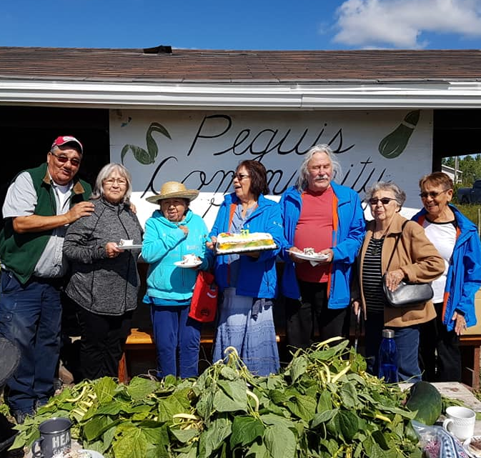
Organizations that work with us.
Workers are employed from a variety of our band members, unemployed, social assistance, students, volunteers from Band departments, Elders..
Departments – Health Centre, Peguis School students, Training & Employment, Jordon’s Principle,
Others: Peguis Development Corporation, TLE Trust, NMFCCC, NHFI, University of Manitoba

Slide 7
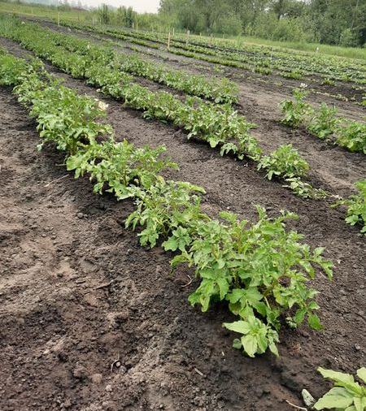
Garden Activities
Spring – Tilling, preparation of Garden, planting, checking equipment, workers, schedules, seed…
Crops – Vegetables – other .. Favorites, potatoes, beets, beans, carrots, tomatoes, corn, peas, squash, Other: Peguis tobacco, new seed potato, new wheat.

Slide 8
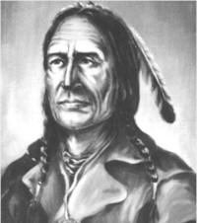
Community Involvement
Band members with their own Gardens
64 gardens in 2021. Great success with their own gardens.
Elders Days.
Community Garden Days.

Slide 9
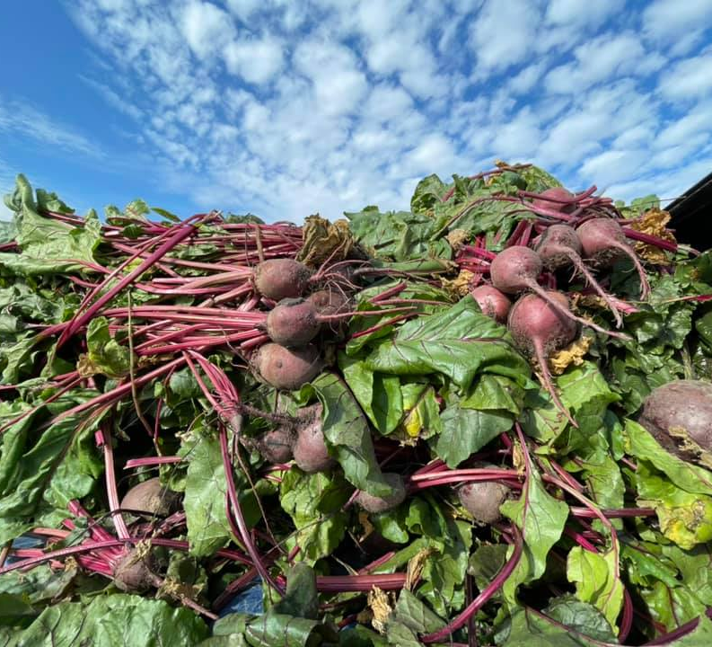
Garden Work - operations
Use 2 Tractors, tillers, mower, harrows, wheel barrows, Watering Equipment, tanker, pump.
Plant by hand, with no Fertilizer, no Chemicals. We try to be organic, till after the harvest, and before planting.

Slide 10
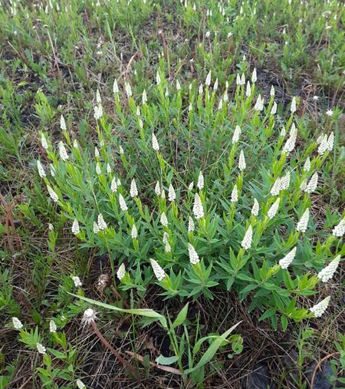
Other works Activities.
Experimental – with University of Manitoba, new crops – Developing a new “Peguis Potato” – our 3rd. Year now. A new Video coming out in May with Erica Daniels & U of Man.
A New Wheat – a perennial wheat, that could be annual crop for several years. (Kernza). Will be our 3rd. Year, a good hay crop.
Seneca Root – have an acre of Seneca root an industry that was here for over a hundred years.
Orchard – we have started a Saskatoon and Raspberry Orchard, hope to expand on this, with other fruit.

Slide 11
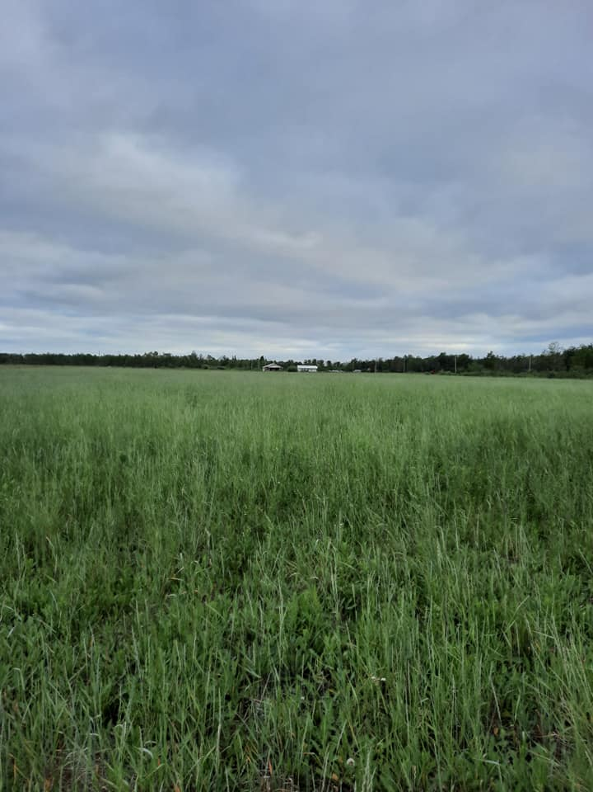
Truth and Reconciliation
As declared by the Federal Government, to use the 96 Recommendations to bring change in our Communities and in Society.
Recognize our Treaty Rights and deal with Systemic Racism in many of the Instituations across the land.
Bring Truth to Canada’s History, education, and how we were portrayed throughout this country’s Colonization of First Nations people.
Recognize the Treaties, Agreements, and Rights of First Nations people.

Slide 12
Defining Food Sovereignty
Every Nation has a universal Right to their own Food Sovereignty.
For Thousands of years, First Nations people had their own Food Sovereignty.
With the Treaties and Surrender of Lands, our people lost much of this Food Sovereignty.
With our people being placed on small Reserves, we lost much of our Food Sovereignty . (Residential Schools – knowledge was not passed on).
Restrictions – The Indian Act – The Pass System – Systemic Racism – Factors of Dependency, ..

Slide 13
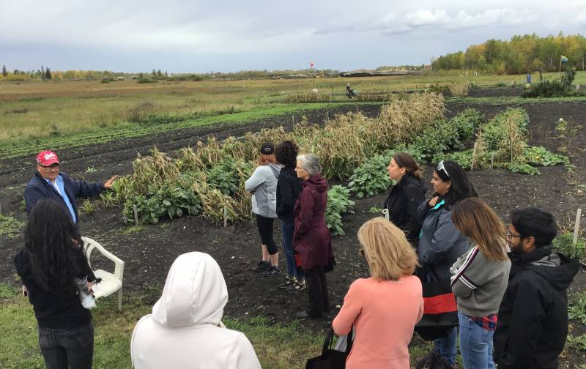
Land Use
Gardens – crops – orchards – fruits – berries
Traditional Gathering – Edibles – berries, plants.
Medicines – We have 3 or 4 groups that gather the medicines, teachings, use, and mapping the gathering areas to protect. Eg. Matootoo Lake.
Other – Cattle, buffalo, poultry, Bees.

Slide 14
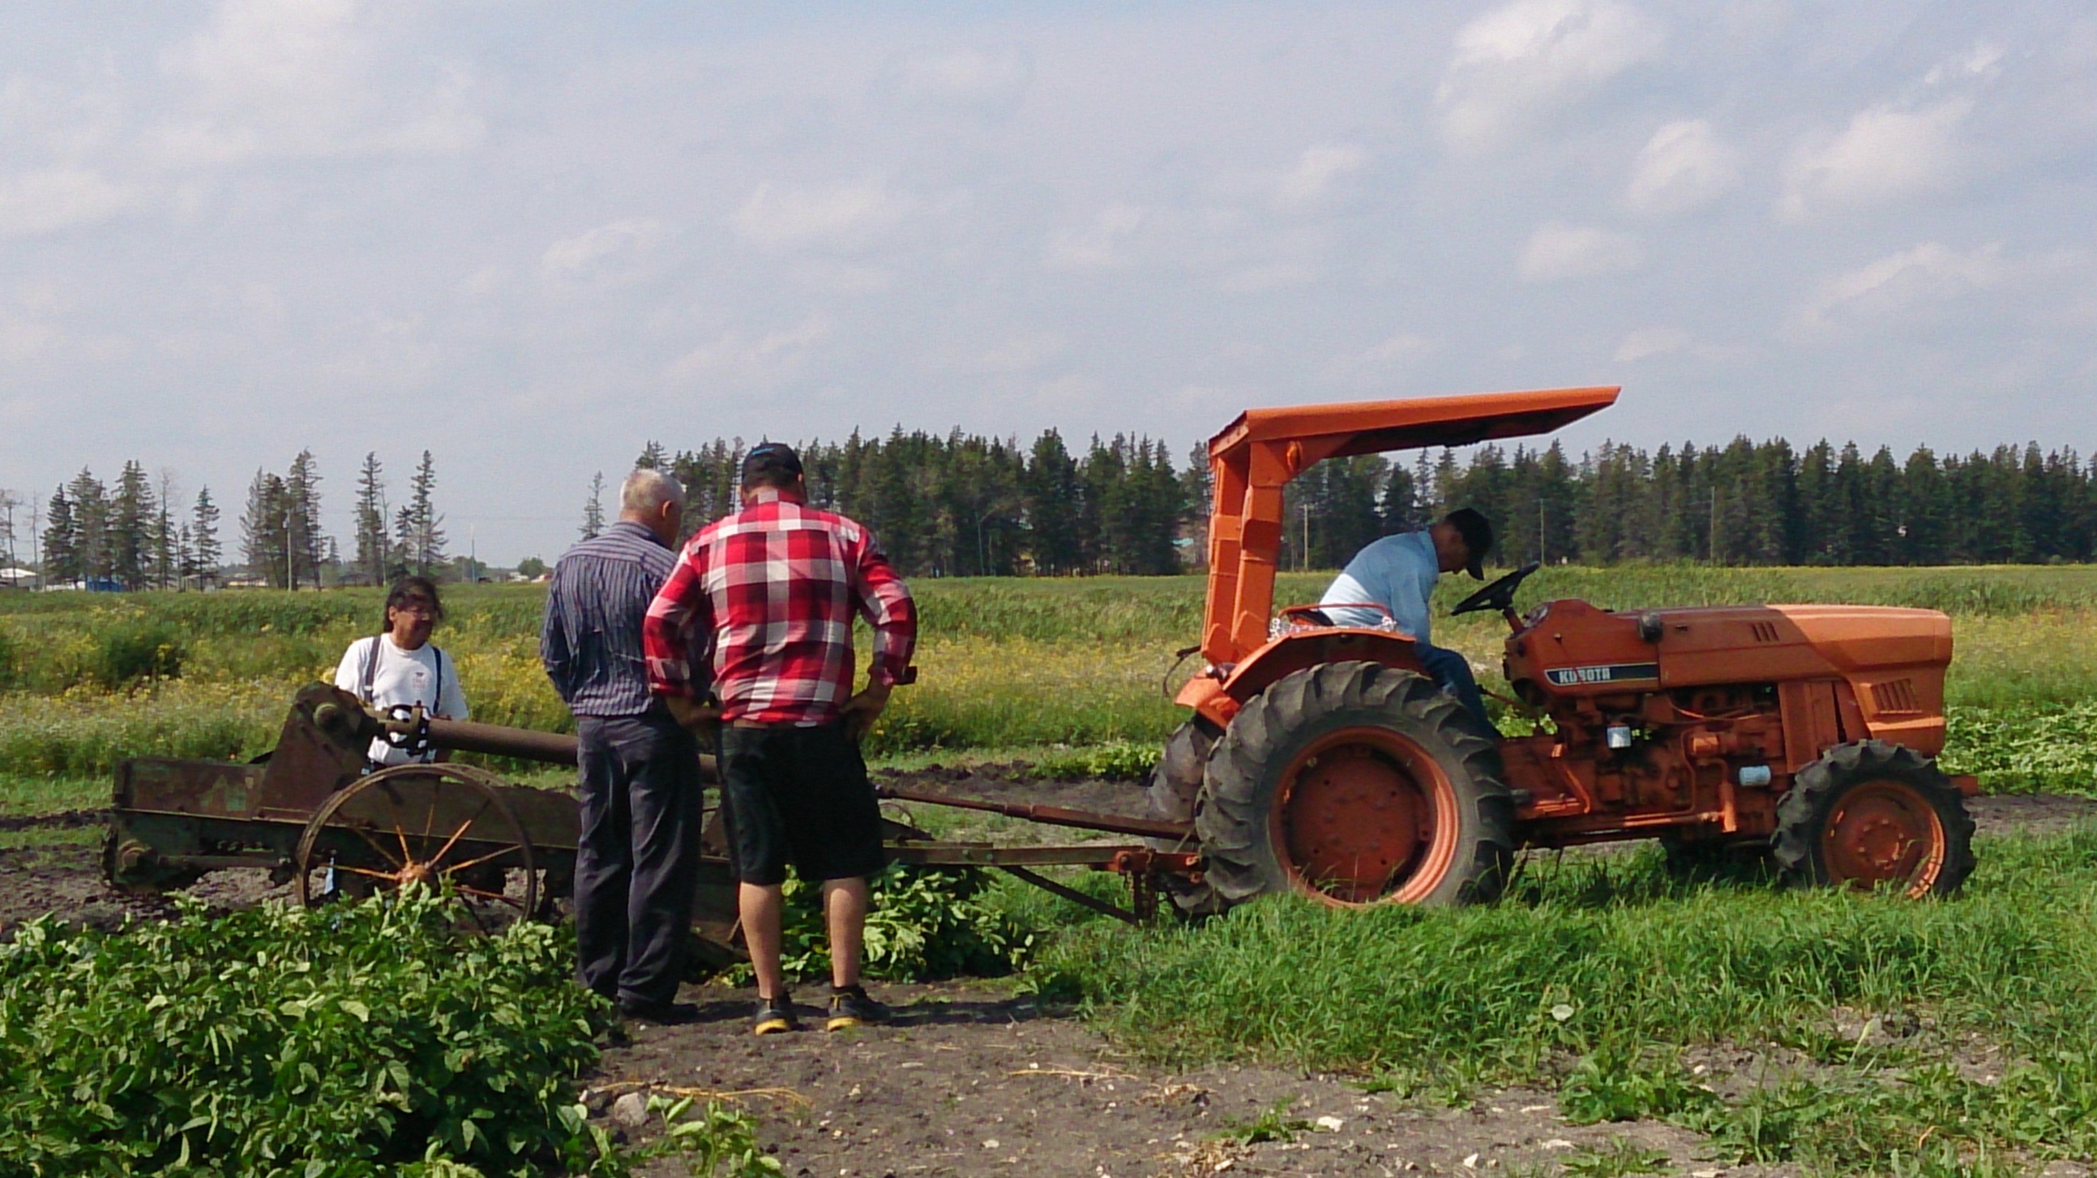
Land, Weather, Climate, Water, Soils.
We are experiencing Climate Change, where western Canada is drier, hotter, in summer, fewer rain falls
Weather can be uprepredictable,
Many of our FN Communities are in the north, shorter growing season, poor soils,
Not included in many programs – eg. Agriculture Canada.
Many FN Communities don’t even have good drinking water.

Slide 15
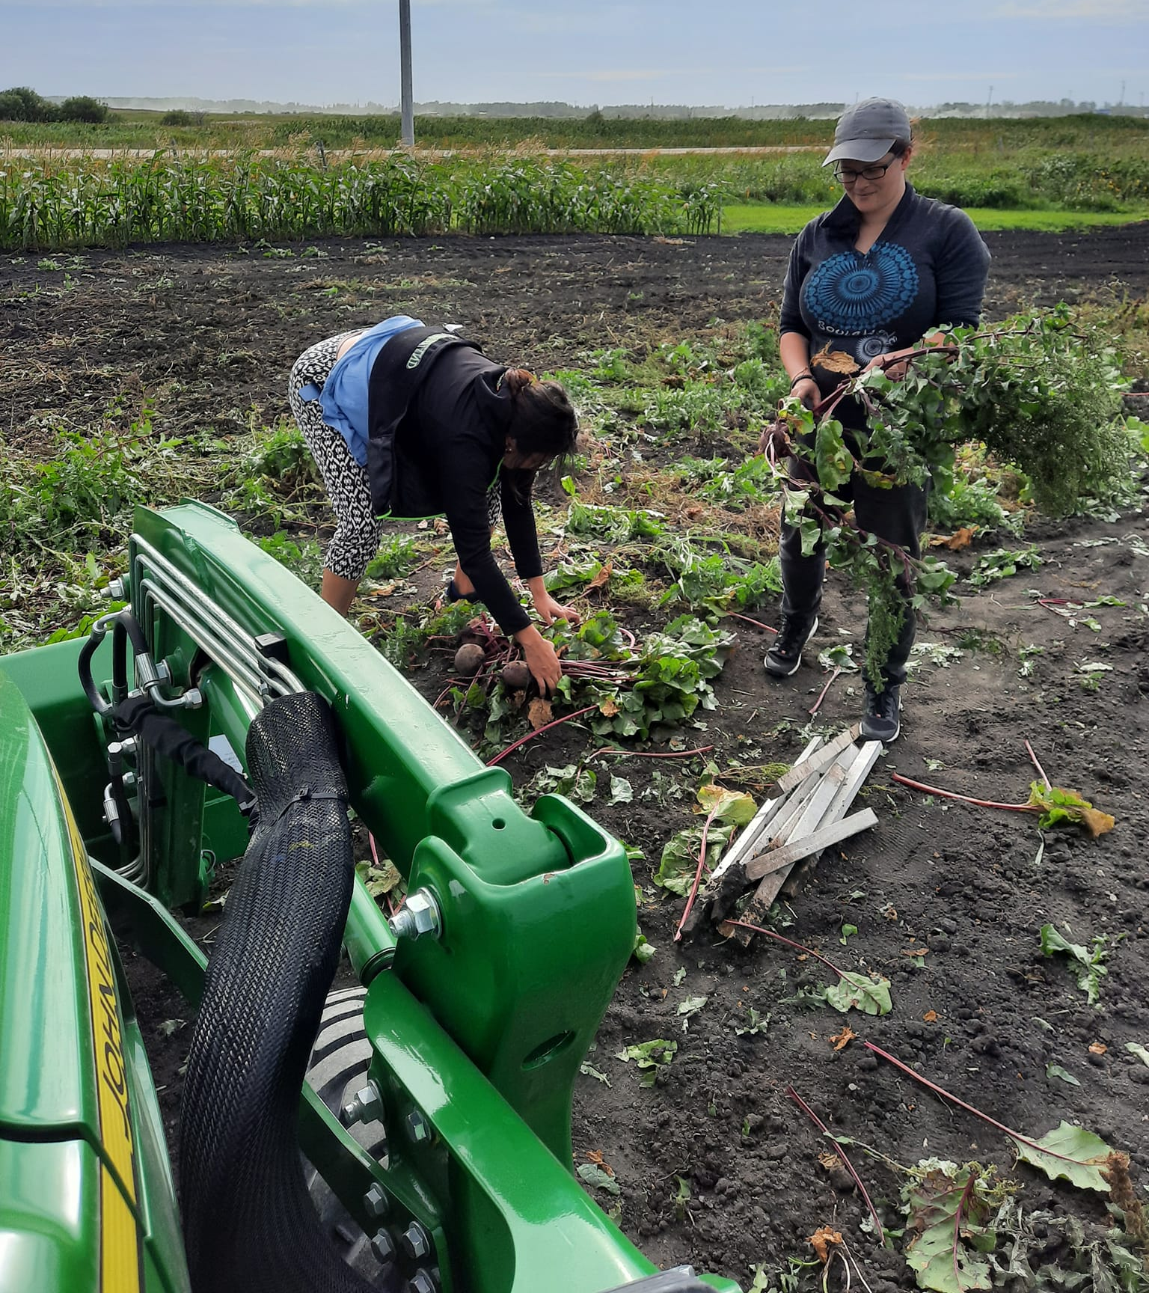
The Need for Food Security in FN.
Food has to be bought in by Air and Train.
Food is very Expensive in the northern Communities.
More Poverty – low income people.
becoming more and more expensive in Northern Communities.

Slide 16
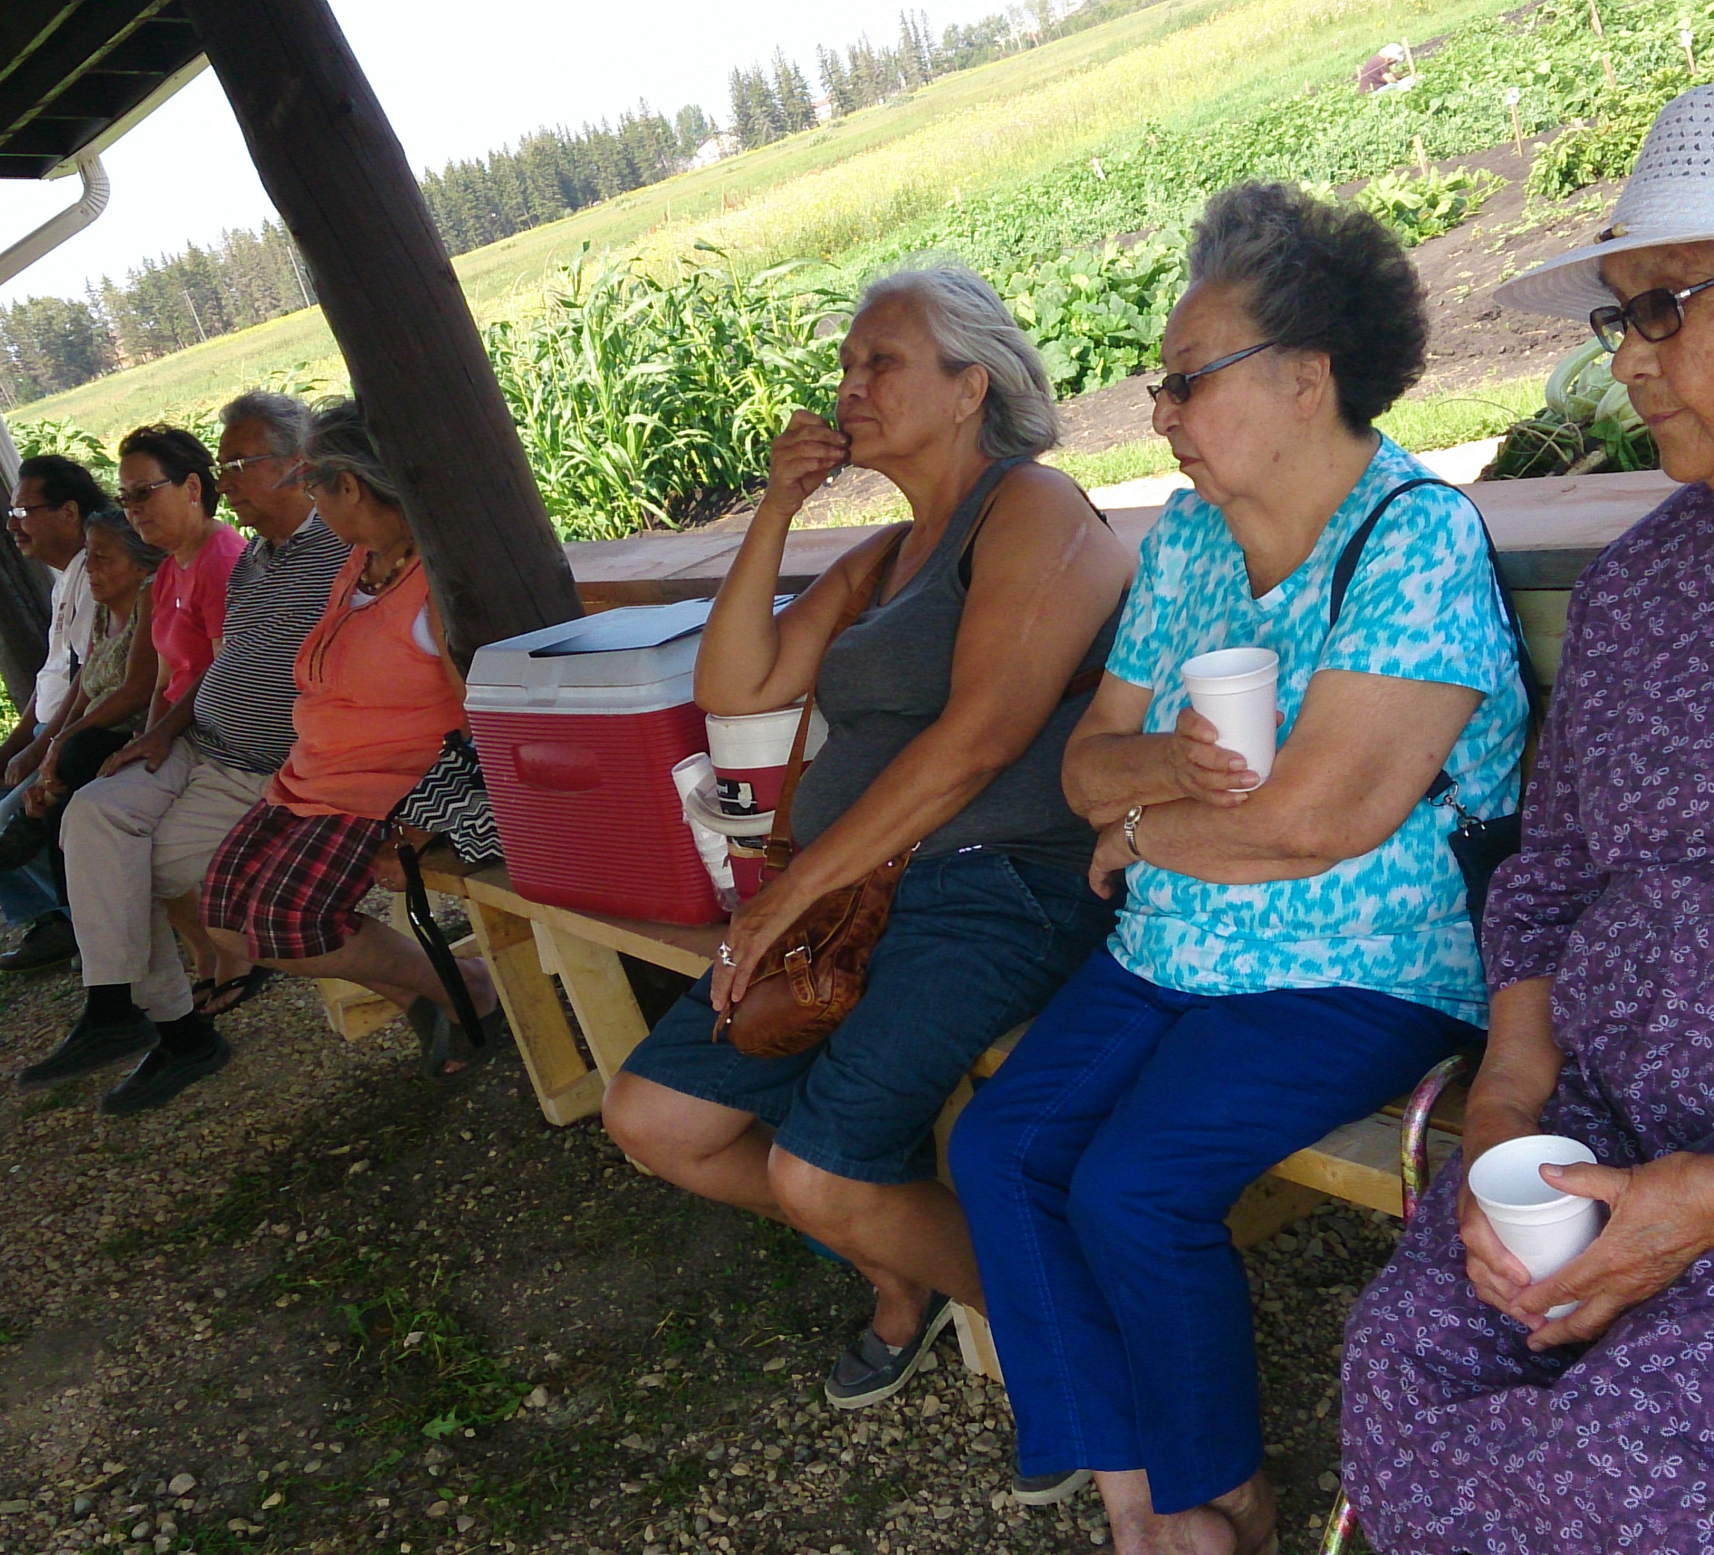
Our Steps to regaining Food Security.
Formed an interested group, share the Vision.
Find a piece of land to develop, common band land.
Deal with Chief and Council, Lands, get land description, legal, and an understanding of land use, sign an Agreement.
Get the Elders together, share Collaborate, and guidance.
Find Funding, fund raise, etc.
Equipment needs, use of volunteers, etc.
Get first Crop in, make it a SUCCESS!!

Slide 17
Discussion Questions Evaluation
Evaluation was part of the operation, to do annual reports, have funders, elders, groups, feedback,
Successes Failures…
Year end Gathering – Elders, youth, gardeners,
Peguis Community Garden Program – Vision.
Our Present and Our Future – what are the determining factors of Success?
Education – how important is it in terms of vision for our children & their future?
Evaluation

